Slide 1
IBM Watson Studio Local Data Refinement

Slide 2


If data is the new oil, where is your industrial refinery?

Slide 3

Data Refinery
It’s a self-service data preparation client for data scientists, data engineers, and business analysts
With it, you can quickly transform large amounts of raw data into consumable, quality information that’s ready for analytics.
Data Refinery makes it easy to explore, prepare, and deliver data that people across your organization can trust.

Slide 4
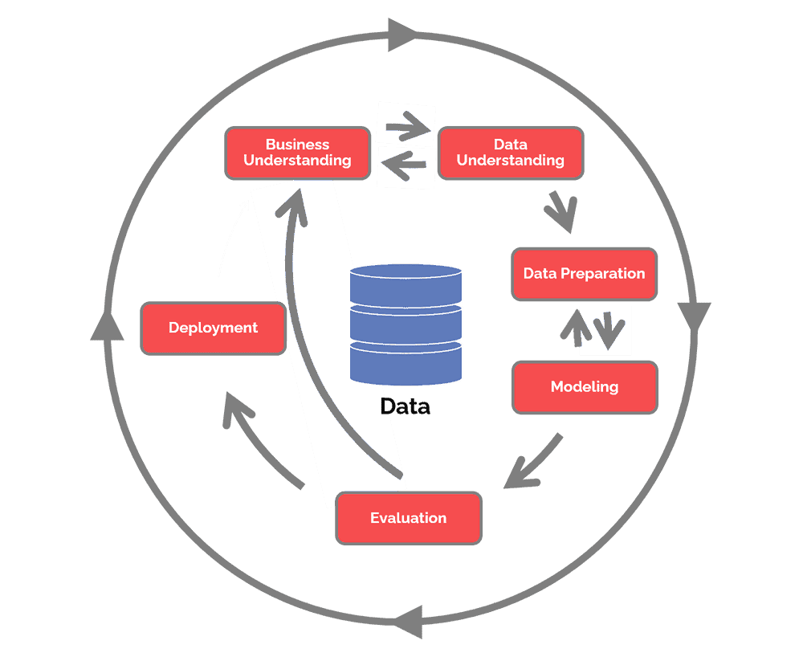
Objectives of This Session
Upon completion of the Learn Data Refinement Session you will:
Understand how to refine data and make it available for your project
Leverage the Data Refinery capabilities
Data Preparation : Refining Raw Data into Value
Notes:
CRISP-DM, which stands for Cross-Industry Standard Process for Data Mining, is an industry-proven way to guide your data mining efforts.
As a methodology, it includes descriptions of the typical phases of a project, the tasks involved with each phase, and an explanation of the relationships between these tasks.
As a process model, CRISP-DM provides an overview of the data mining life cycle.
The life cycle model consists of six phases with arrows indicating the most important and frequent dependencies between phases. The sequence of the phases is not strict. In fact, most projects move back and forth between phases as necessary.
The CRISP-DM model is flexible and can be customized easily. For example, if your organization aims to detect money laundering, it is likely that you will sift through large amounts of data without a specific modeling goal. Instead of modeling, your work will focus on data exploration and visualization to uncover suspicious patterns in financial data. CRISP-DM allows you to create a data mining model that fits your particular needs.
In such a situation, the modeling, evaluation, and deployment phases might be less relevant than the data understanding and preparation phases. However, it is still important to consider some of the questions raised during these later phases for long-term planning and future data mining goals.

Slide 5














The Problem: Data Is Neither Available nor Relevant
Business Users use what’s available, not what is best. Data must go from the hands of the few and to the hands of the many.
All Data
New/Enhanced Applications
IT and
Data Stewards
Business User
Application Developer
Notes:
Key Points
Let’s look at the business problem from the POV(point of view) of three audiences – the business user, the application developer and IT professionals.
These three audiences are related to one another and in a lot of organizations, work against one another.
IT team – manage the long tail of information – data lake
Application developer – build microservice applications that interact with data and model
Business user – from static reports to information discovery, analytic application rather than reports and queries
Transition
Let’s take a closer look at the business user

Slide 6
Reasons Why Your Organization Still Isn’t Data-Driven
61%
33%
Poor Data Quality
Difficult-to-use tools
53%
21%
No single version of truth
Weak data literacy
Source: https://www.forbes.com/sites/brentdykes/2021/06/01/10-reasons-why-your-organization-still-isnt-data-driven/?sh=668c19207d80
Notes:
#3. Poor data quality
In an Accenture study, only 33% of firms reported they trusted “their data enough to use it effectively and derive value from it.” It’s difficult to make much progress with your data initiatives when people don’t have faith in the numbers due to data quality issues. While data will never be perfect, people need to have a certain level of confidence that the underlying data accurately reflects what’s happening. If you see your data as a business asset but don’t address ongoing data quality issues, you can’t be surprised when the data isn’t being used on a regular basis.
#4. No single version of truth
In a 2019 report by Arm Treasure Data, 47% of marketers indicated their data was “siloed and difficult to access.” If it’s hard to get a consolidated picture within a single department, it can be even harder to establish a single version of truth across an entire business. When different individuals and teams are left to define their own truth, it can lead to confusion and a lack of cohesion. Nobody is sure whose numbers are the “right ones.” As a result, the organization can’t ensure its people are pulling in the same direction.
#5. Weak data literacy
If most of your workforce isn’t comfortable working with data, you will only see it being used sporadically at best. A Qlik/Accenture survey revealed only 21% of workers were fully confident in their data literacy skills, which can be defined as the ability to read, understand, question and work with data. Even though employees increasingly have more data at their fingertips, 74% expressed feeling overwhelmed or unhappy when working with data. Without ample training and support, people will struggle to embrace something they don’t understand and find intimidating.
#7. Detached data workflows
If your analytics tools aren’t integrated into your employees’ existing business processes, they won’t gain nearly as much acceptance. In an interview with McKinsey, Cameron Davies, formerly the Head of Corporate Decision Sciences at NBCUniversal, said his analytics team would identify “places where people are already making decisions.” His team would then “review the processes they use and try to identify either the gaps in the available data or the amount of time and effort it takes to procure data necessary to make an evaluation, insight, or decision.” By integrating the tools into people’s existing workflows, data becomes a more natural extension of their work and not an extra responsibility or task.

Slide 7
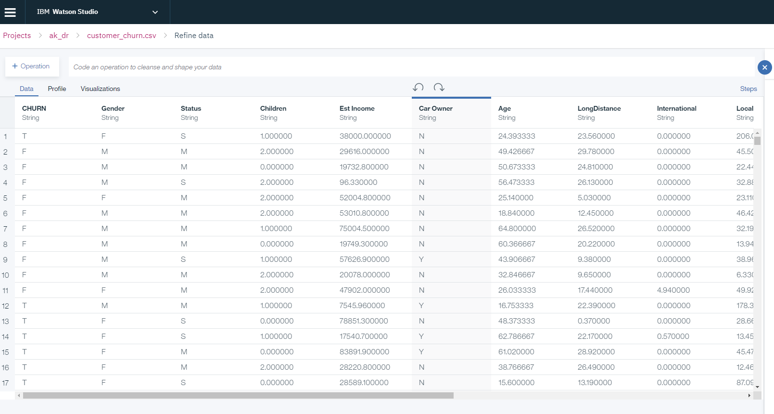
Data Refinery Features
1
Analyze and transform your data
Interactively discover, cleanse and transform your data with over 100 built-in operations. No coding skills are required.
Notes:
Before you analyze local data sets, you can refine the data by cleansing and shaping it.
Cleanse the data
Fix or remove data that is incorrect, incomplete, improperly formatted, or duplicated.
Shape the data
Filter, sort, combine, or remove columns, and perform operations.

Slide 8
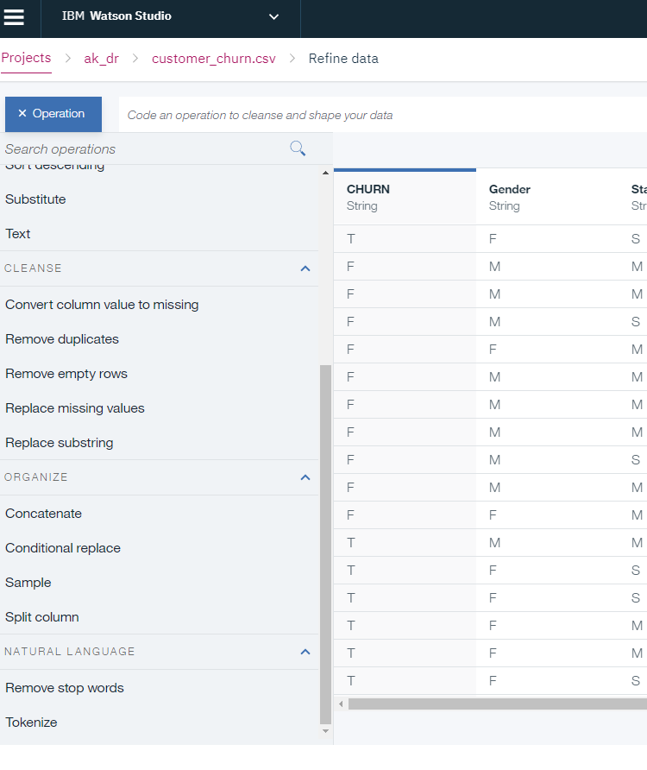
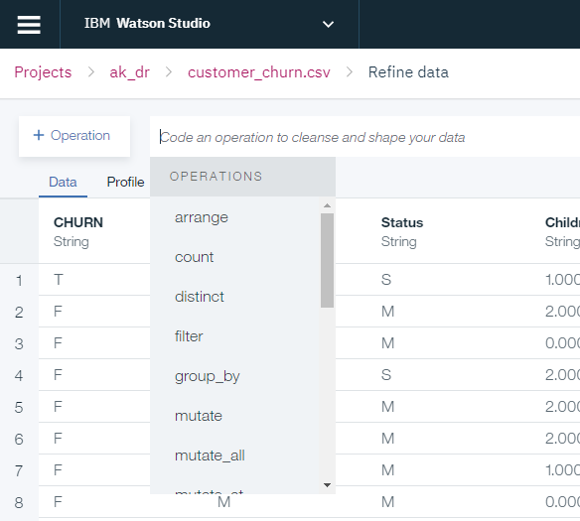
Operations for Refining Data
Operation button
Data Refinery also provides the ability to define additional refinement capabilities through a set of dplyr functions with guided prompts
1
2
1
2
3
Notes:
Screen shot of Data Refinery page where you can see the different operations that can be performed to enhance your data sources.
Discuss this screen within the context of the Data Flow Asset from the previous asset list…
Discuss this screen in terms of the Customer File asset that got selected & concepts around cleansing / refining data for the enterprise
https://dplyr.tidyverse.org/reference/index.html

Slide 9
Calculate
Perform a calculation with another column or with a specified value. The operators are:
Addition
Subtraction
Multiplication
Division
Modulus
Exponentiation
Is equal to
Is not equal to
Is less than
Is less than or equal to
Convert column type
Convert the type of the column to a different data type.
A column's data type determines the operations you can perform. Changing the data type can affect which operations are relevant for that column.
Remove
Remove the selected column.
Rename
Rename the selected column.
Sort ascending
Sort rows by the selected column in ascending order.
Sort descending
Sort rows by the selected column in descending order.
Substitute
Obscure sensitive information from view by substituting a random string of characters for the actual data in the selected column.
Organize operations:
Concatenate
Concatenate the values of two or more columns.
Join
Not supported.
Split column
Split the column by non-alphanumeric characters, position, pattern, or text.

Slide 10
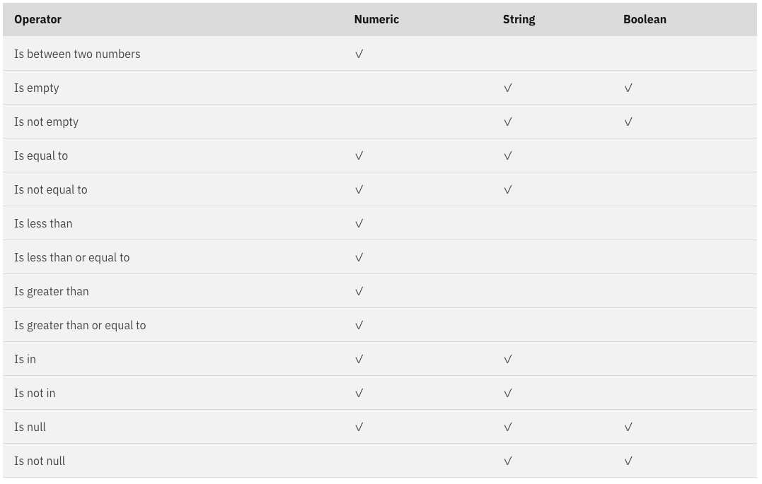
Filter
Filter rows by the selected columns. Keep rows with the selected column values; filter out all other rows.
The filter operators for numeric, string, and Boolean (logical) columns are:
Math
You can apply math operations only to numeric columns.
Absolute value
Get the absolute value of a number. Example: The absolute value of both 4 and -4 is 4.
Arc cosine
Get the arc cosine of an angle.
Ceiling
Get the nearest integer of greater value, also known as the ceiling of the number. Examples: The ceiling of 2.31 is 3. The ceiling of -2.31 is -2.
Exponentiation
Get a number raised to the power of the column value.
Floor
Get the nearest integer of lesser value, also known as the floor of the number. Example: The floor of 2.31 is 2. The floor of -2.31 is -3.
Round
Get the whole number nearest to the column value. If the column value is a whole number, return it.
Square root
Get the square root of the column value.

Slide 11
Text
You can apply text operations only to string columns.
Collapse spaces
Collapse multiple, consecutive spaces in the text to a single space.
Concatenate string
Link together any string to the text. You can prepend the string to the text, append the string to the text, or both.
Lower case
Convert the text to lower case.
Number of characters
Return the number of characters in the text.
Pad characters
Pad the text with the specified string. Specify whether to pad the text on the left, right, or both the left and right.
Title case
Convert the text to title case.
Trim quotes
Remove single or double quotation marks from the text.
Trim spaces
Remove leading, trailing, and extra spaces from the text.
Upper case
Convert the text to upper case.
Cleanse operations:
Convert column value to missing
Convert all column values to missing values or convert only the specified column value to a missing value.
Remove duplicates
Remove rows with duplicate column values.
Remove empty rows
Remove rows that have a blank or missing value for the selected column.
Replace missing values
Replace missing values in the column with a specified value or with the value from a specified column in the same row.
Replace substring
Replace the specified substring with the specified text.
Notes:
Pad characters are characters used to fill up remaining available character spaces in a field. For example, if a field requires a minimum of 15 characters, a user may type computerhope***,

Slide 12
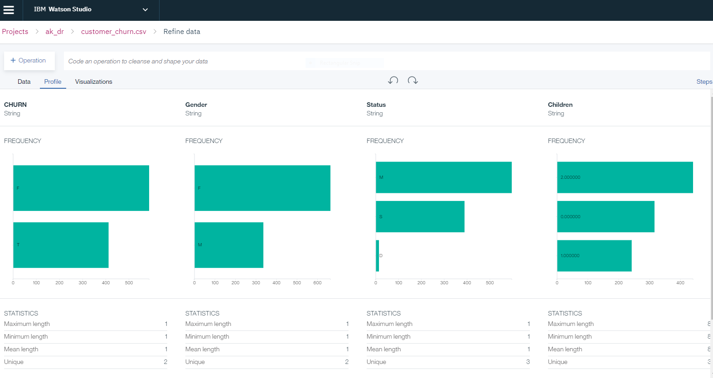
2
Profile data
Understand the quality and distribution of your data using dozens of built-in charts, graphs and statistics. Automatically detect data types and business classifications.
Frequency
The number of times that a value, or a value in a specified range, occurs. Each frequency distribution (bar) shows the count of unique values in a column.
Statistics
A collection of quantitative data. The statistics for each column show the minimum, maximum, mean, and number of unique values in that column. Depending on a column's data type, the statistics for each column will vary slightly.
For example, statistics for a column of data type integer have minimum, maximum, and mean values while statistics for a column of data type string have minimum length, maximum length, and mean length values.

Slide 13
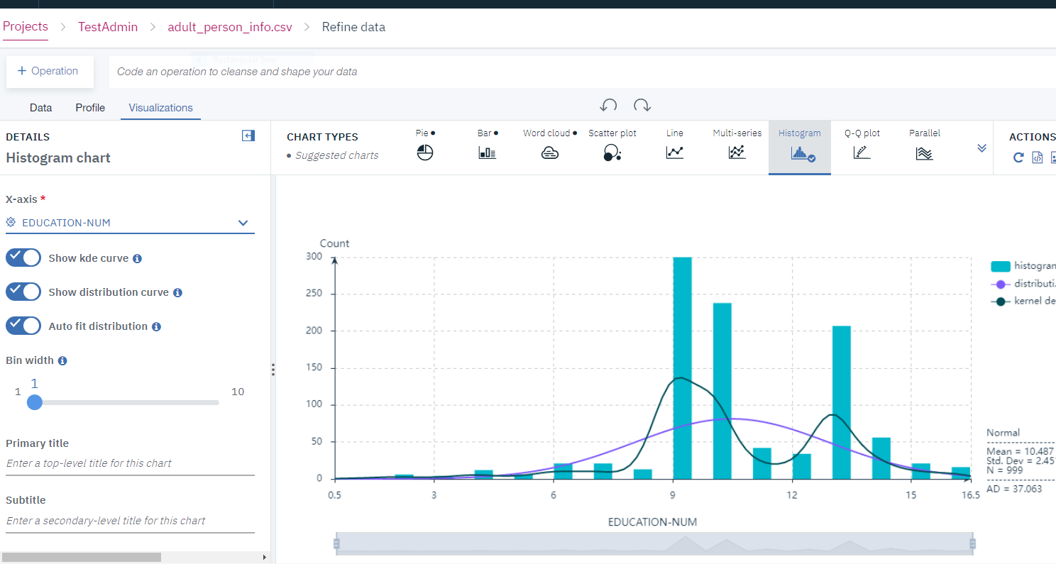
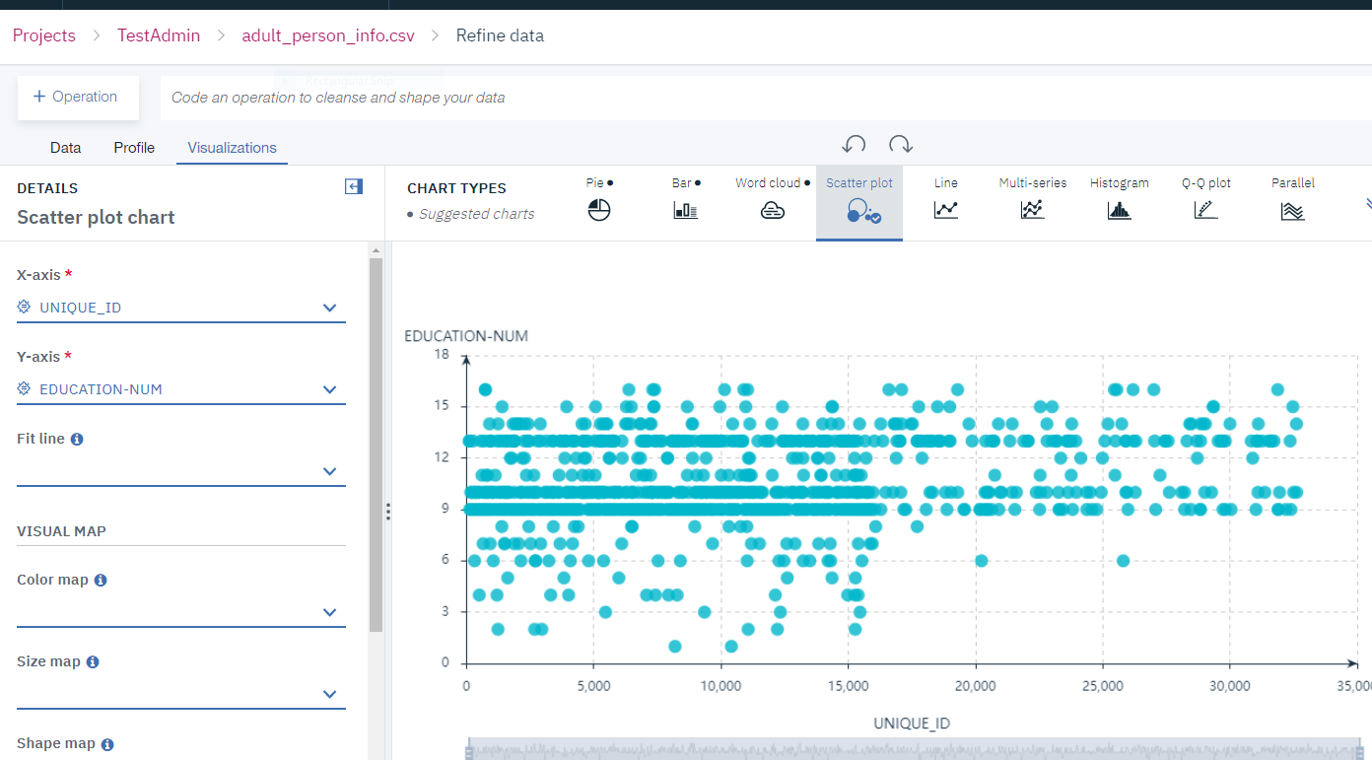
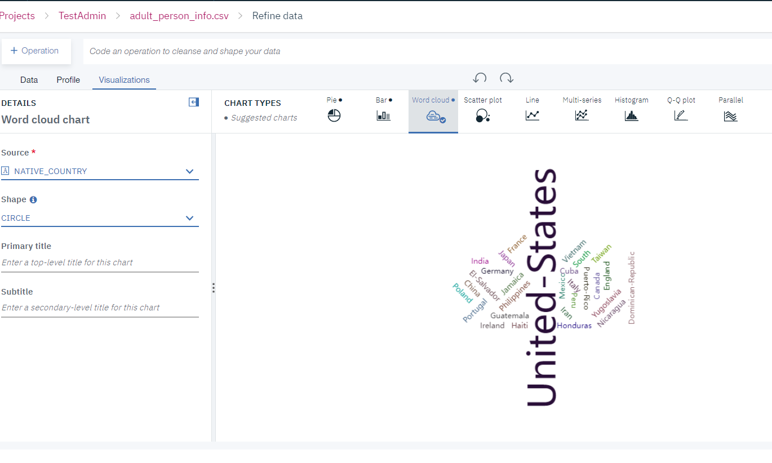
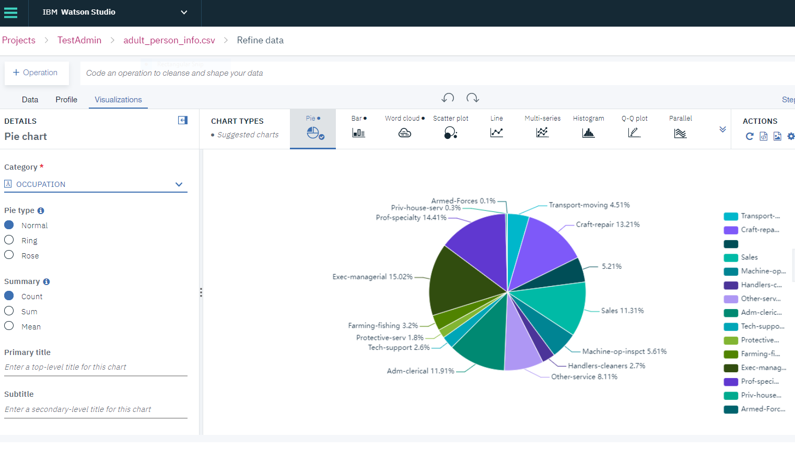
3
Visualize data
Provide insights and uncover patterns, trends, and correlations in your data
Notes:
Before you analyze local data sets, you can refine the data by cleansing and shaping it.
Cleanse the data
Fix or remove data that is incorrect, incomplete, improperly formatted, or duplicated.
Shape the data
Filter, sort, combine, or remove columns, and perform operations.
Rich data visualizations, profiling and transformations of the IBM Data Refinery experience make it easy to interactively explore data of any volume anywhere
Data Engineers drive data preparation with graphical flows for persistent and streaming sources
This makes is easy to drive consistency and adapt to change in data sources while monitoring, managing and governing data flowing into your analytics catalog and projects

Slide 14
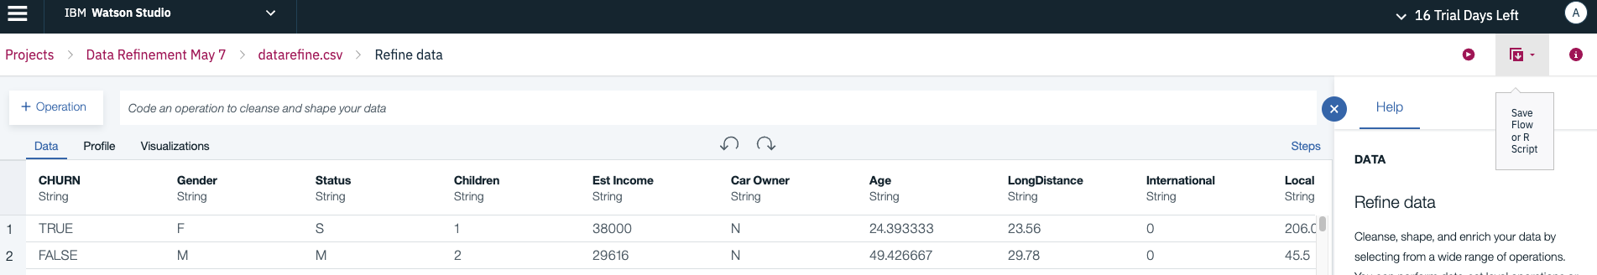
3
Create a data flow and Run the flow as a job
To build a new data flow that refines your data

Slide 15
Questions

Slide 16
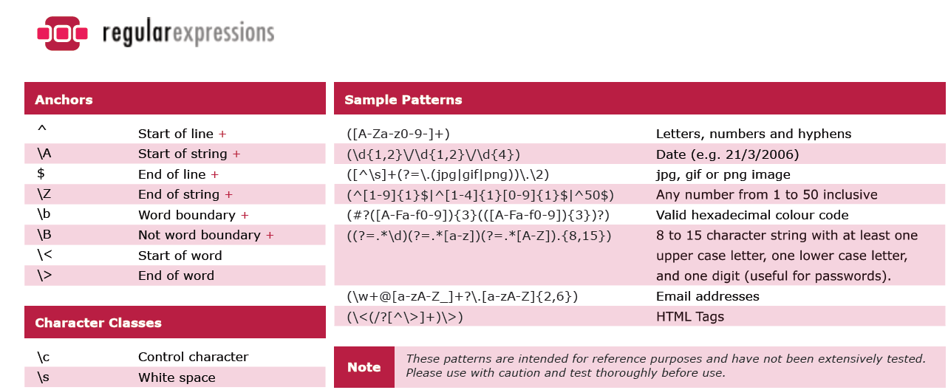
regular expression
Notes:
A regular expression is a sequence of characters that specifies a search pattern.
http://stanford.edu/~wpmarble/webscraping_tutorial/regex_cheatsheet.pdf

Slide 17
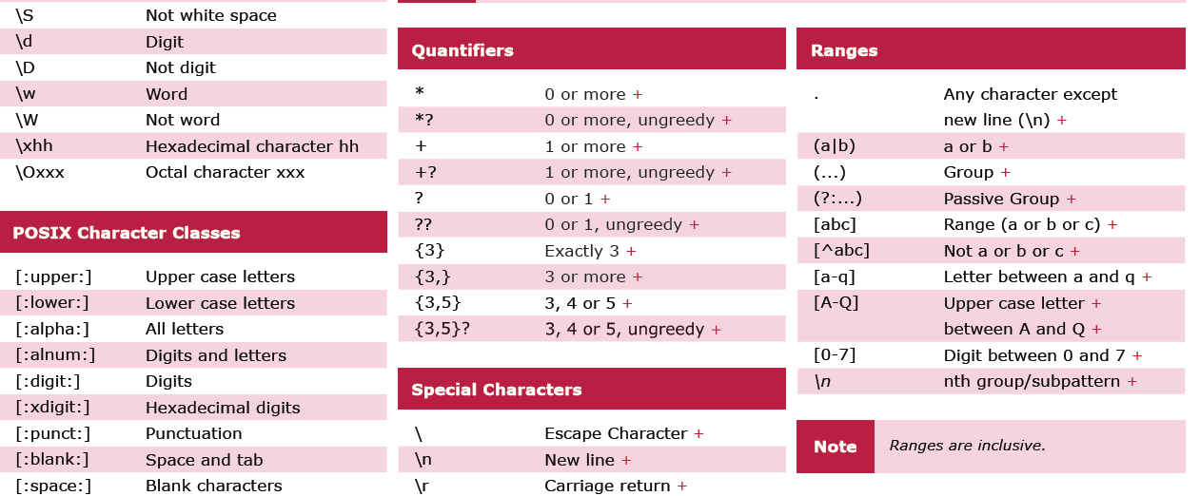

Slide 18
